Slide 1


Final Report
Trial Project
Aug 09, 2021
YOUR TRUSTED PARTNER
FOR SOFTWARE DEVELOPMENT
Author:
Phan Hải Long
Huỳnh Hữu Lộc
2021

Slide 2



Trial Project

Slide 3
Library
com.squareup.picasso:picasso:2.71828
com.squareup.retrofit2:retrofit:2.7.1
com.squareup.retrofit2:converter-gson:2.1.0
com.squareup.okhttp3:logging-interceptor:4.9.1
androidx.recyclerview:recyclerview:1.2.1

Slide 4

Splash Screen

Slide 5
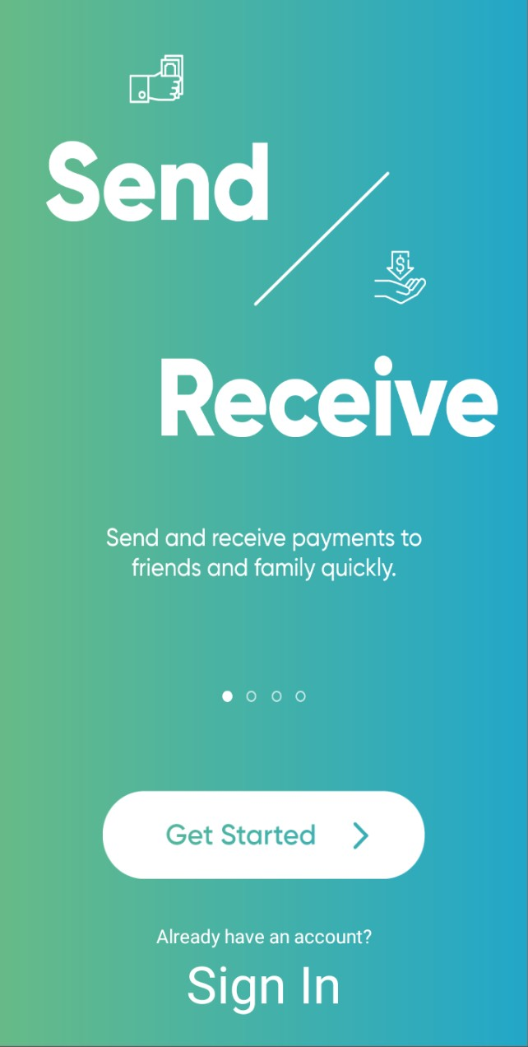
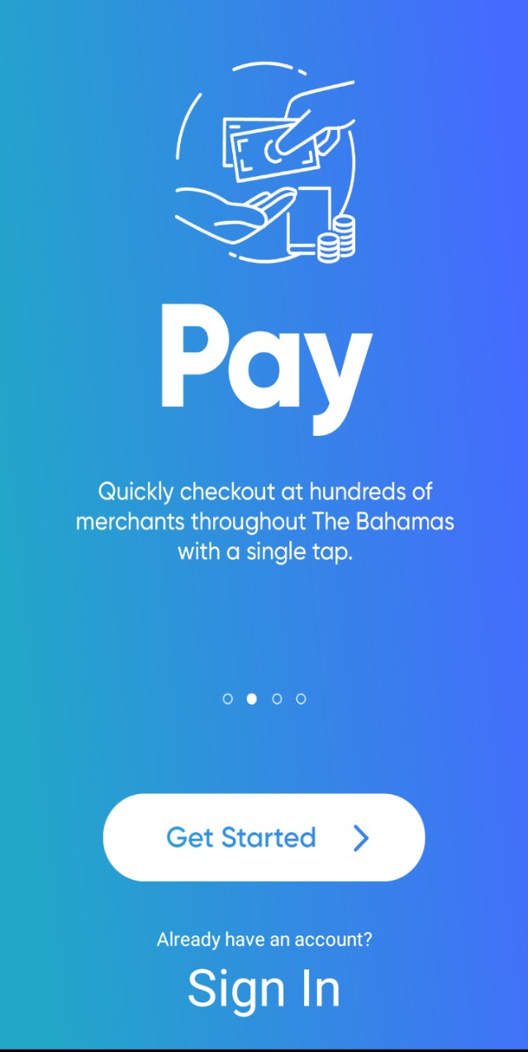

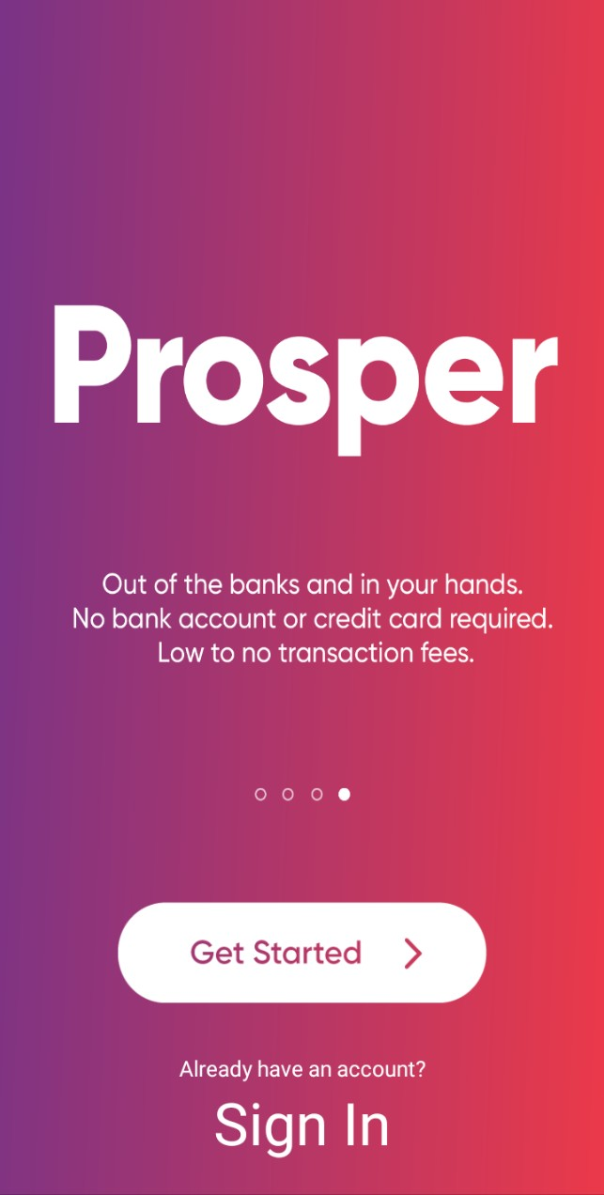
Walk-through Screen

Slide 6
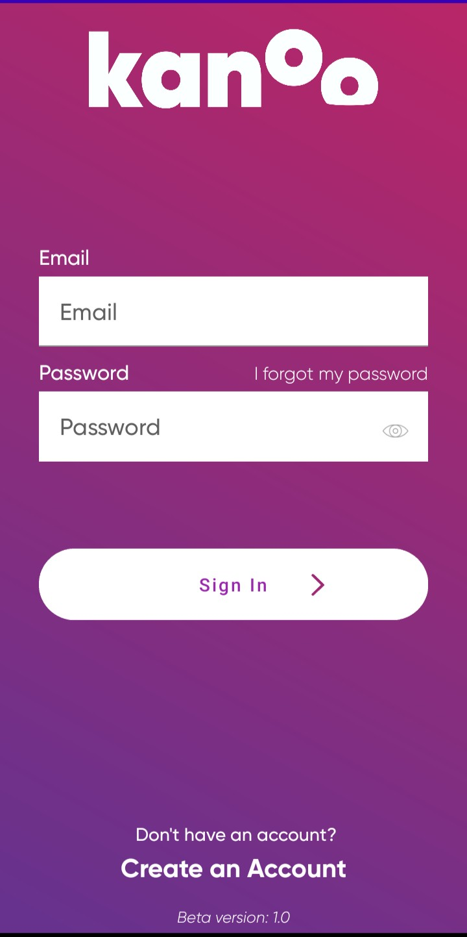
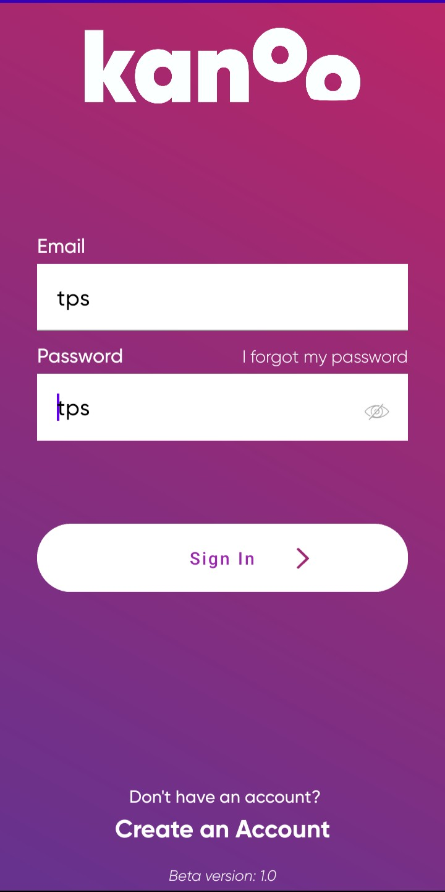
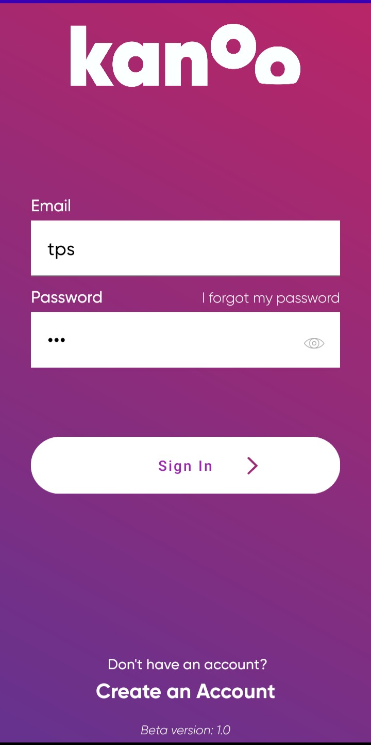
Sign In

Slide 7
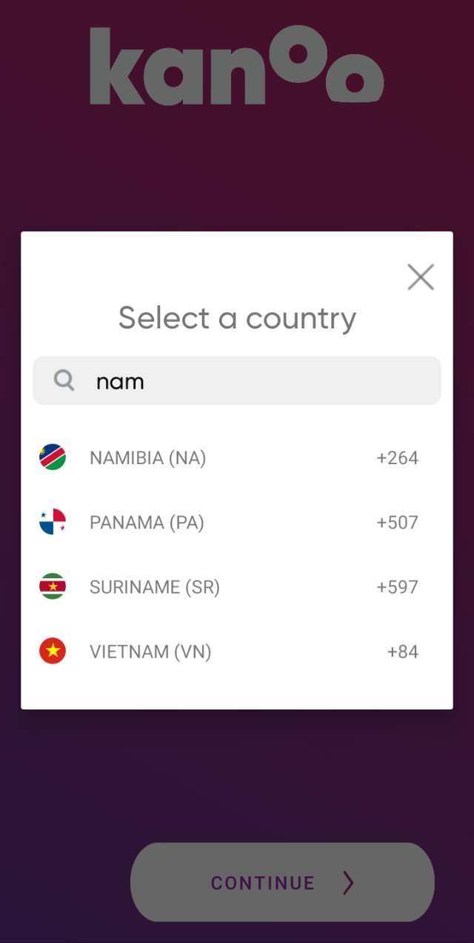
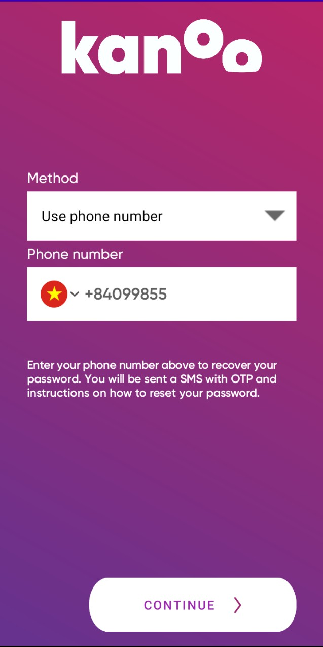
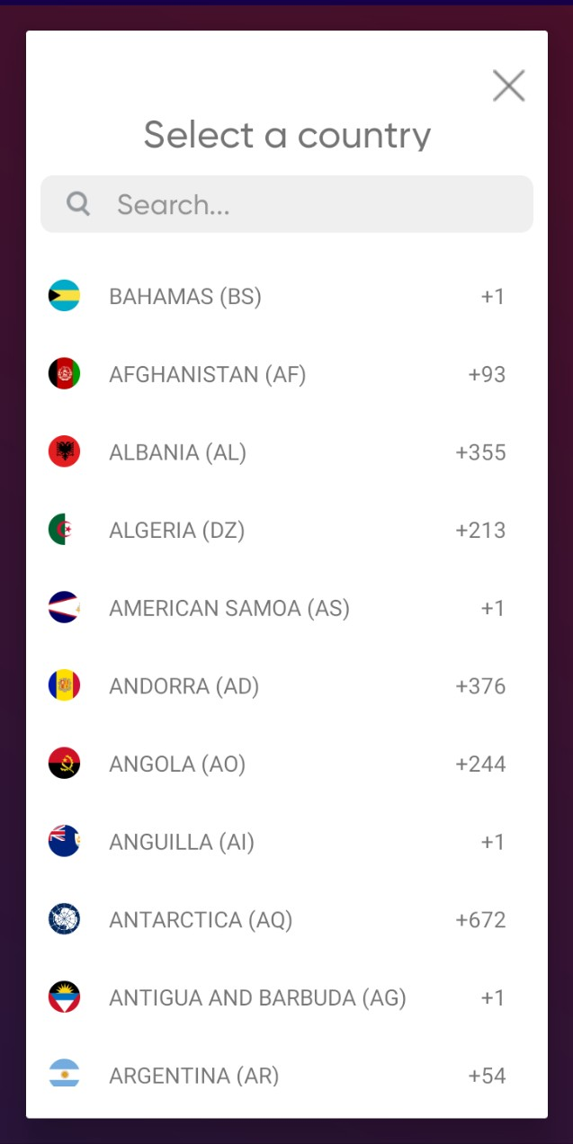
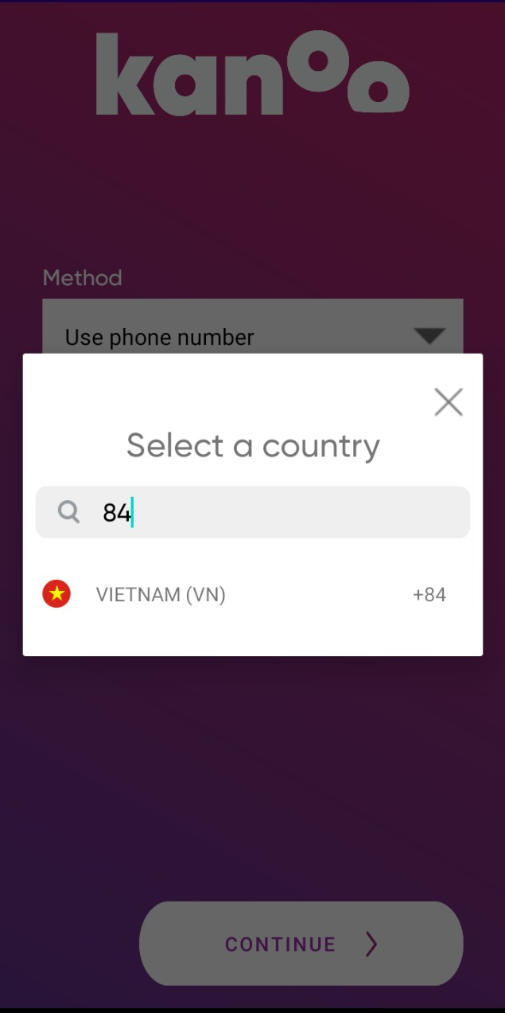
Forgot Password

Slide 8

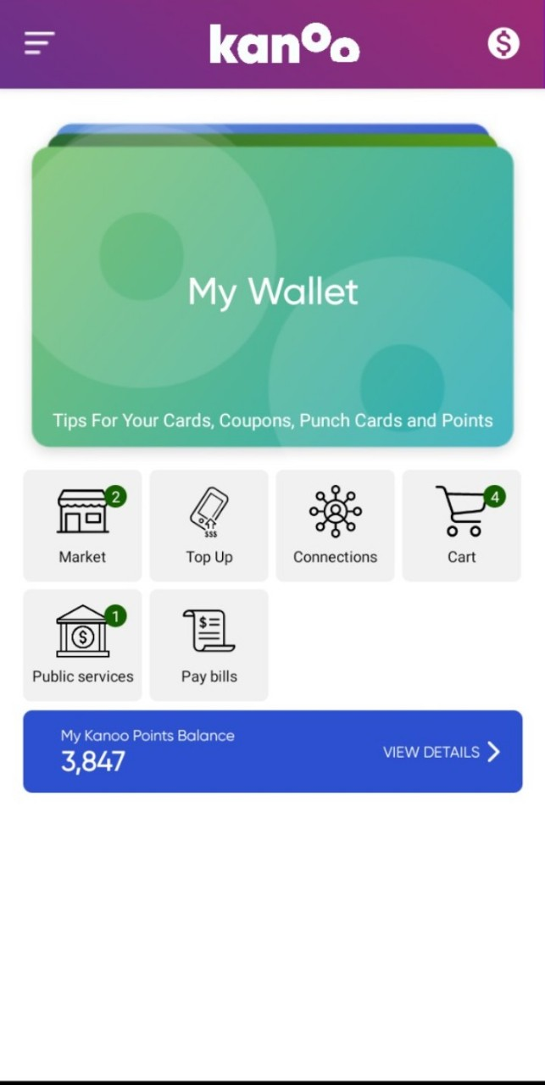
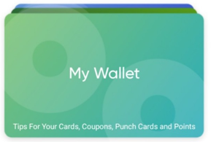
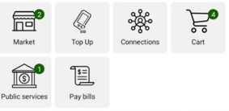

Main Screen

Slide 9
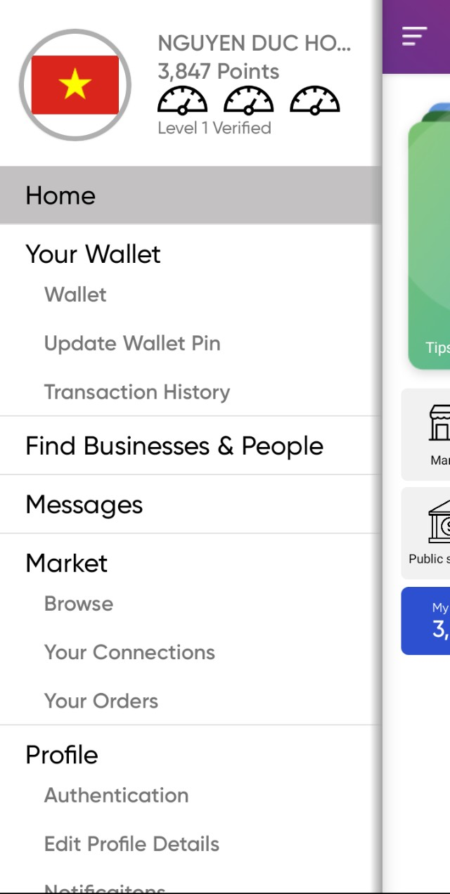
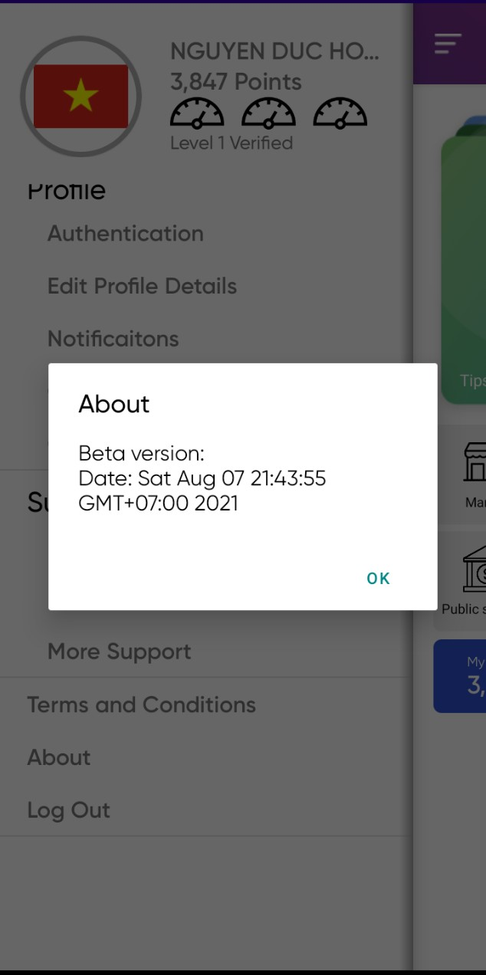
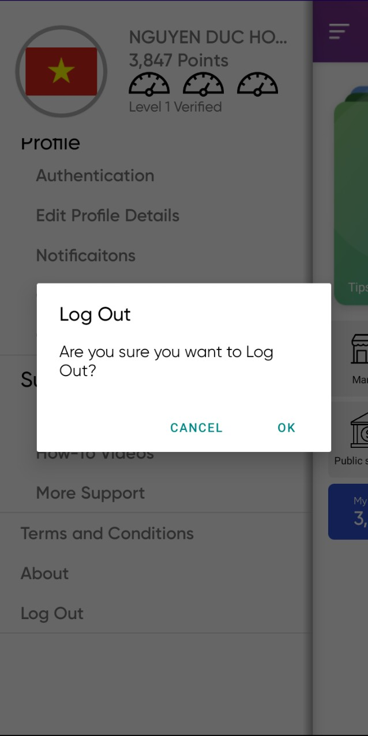
Left Menu

Slide 10
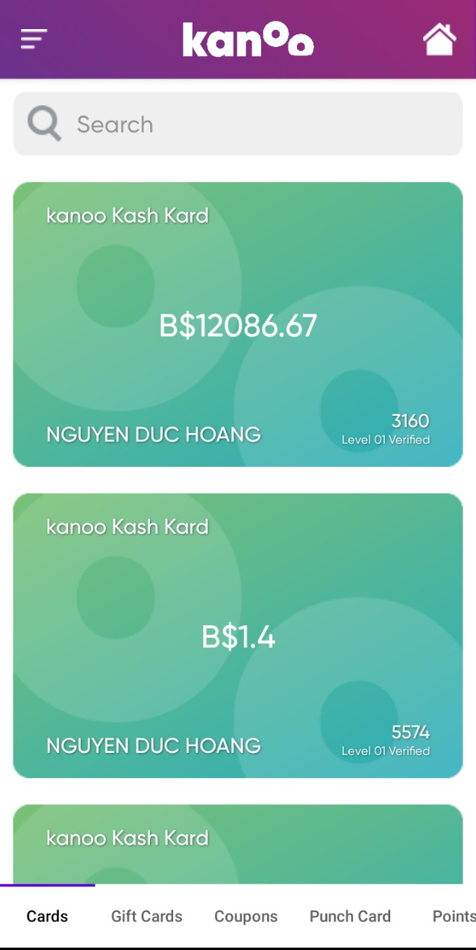
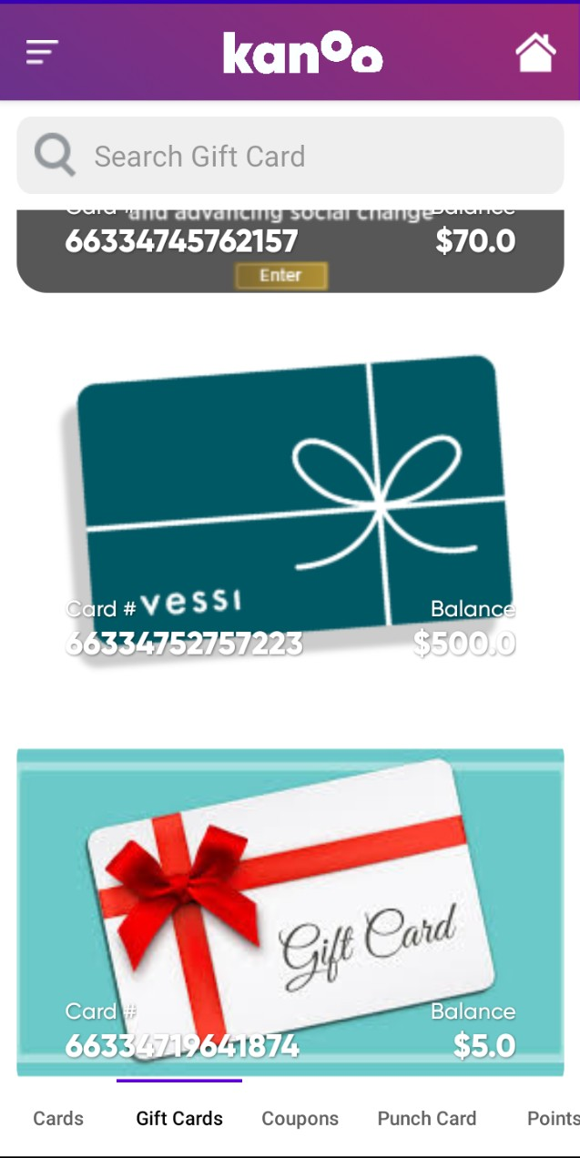
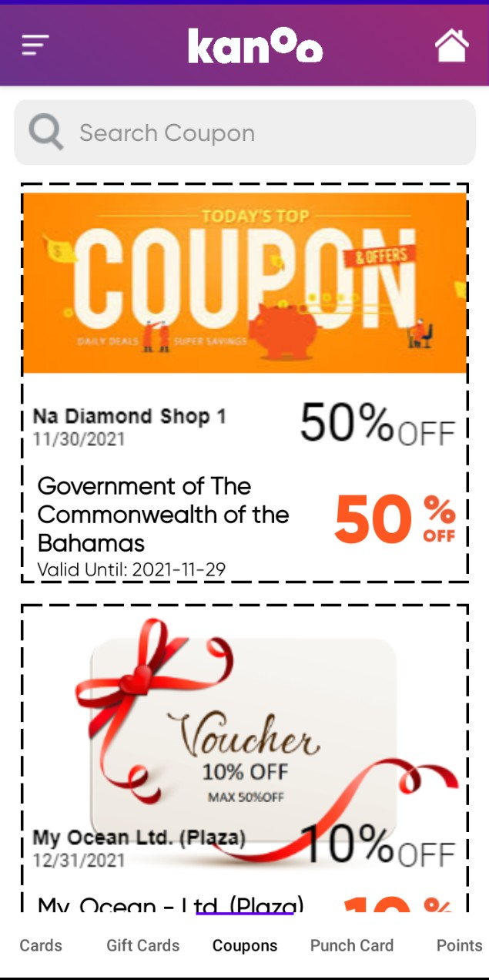
Cards Screen

Slide 11
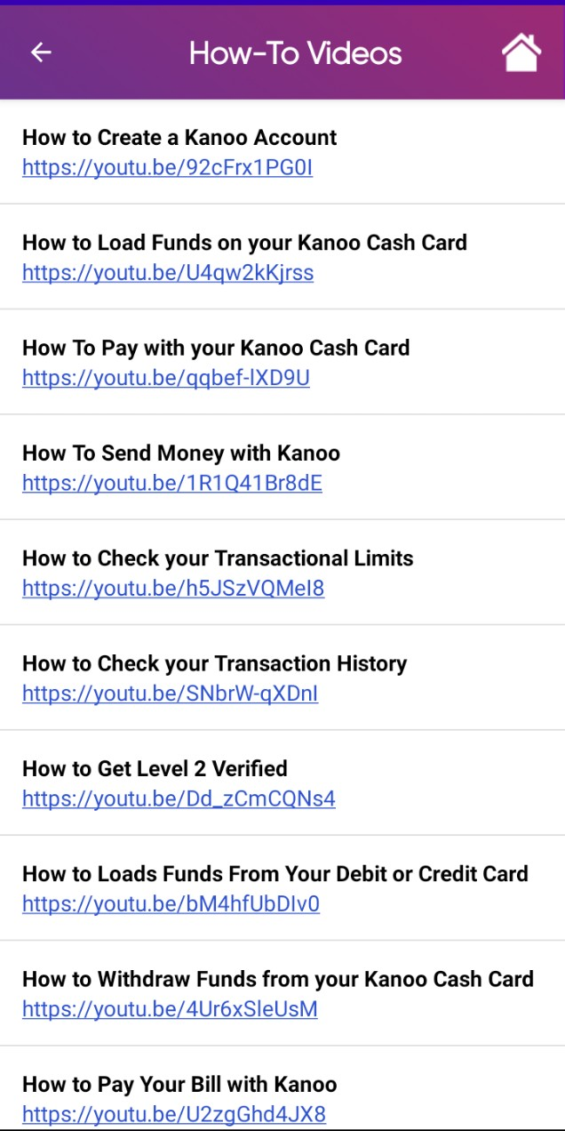
How to videos

